Slide 1
The printing hub(online printing)
Guided BY : Janak tank Hod: Shivangi surati
Modi Kashyap : 219sbece30503
suryavanshi Mahirajsinh :219sbece30504
jadeja daxrajsinh : 17sbece30200
Krishna Solanki : 18SBECE30533

Slide 2
introduction : purpose :
He/she can check design of all types of cards ,wedding cards,benner,invitation cards,
In our web application we are provide all types of facility in delivery
Like currier,transpotaion,etc.
User can see our all services.
User can give order for any type of printing.
User can see and check his/her order status.

Slide 3
scope :
The scope of our web application . It is internet based web-application.
Our web application is reach is Gujarat , rajasthan ,maharastra,Madhya Pradesh,delhi.

Slide 4
Product :
Our concept is all new and modern plat form in printing line .when his/her order is complete so we can delivered his/her order.

Slide 5
Product function
User can check order status
User can ask question to relate our business
User can view history of his/her order.
User can give review
User can change

Slide 6
Assumptions and dependencies
Our system is user friendly
The specific hardware and soft ware product
On the basis of disting and requirement and specification.
The project will be developed.

Slide 7
Requirement : admin
R1 :sign in
input : admin name, password
output : success
r2 : block owner
Input : user id
Out put : success
R3 : manage order
Input : order id , delivery date
output : success
R4 : approve seller
Input : seller id
Output : successfully registered

Slide 8
Requirement : owner
R1 : register
Input : name , shop name , shop address , email
output : registration successfully
R2 : login
Input : user id , password
Output : success full
R3: place order
Input : content file (cdr), qty, dmention,paper type
Output: order id , successfully placed
constraint: user must be login
R4 : cancel order
Input : order id
Output : order cancel
constraint: user must be placed order
R5 : order history
Input : date
Output : list of order

Slide 9
Requirement : user
R1 : check order status
Input : order id
Output : status of order

Slide 10
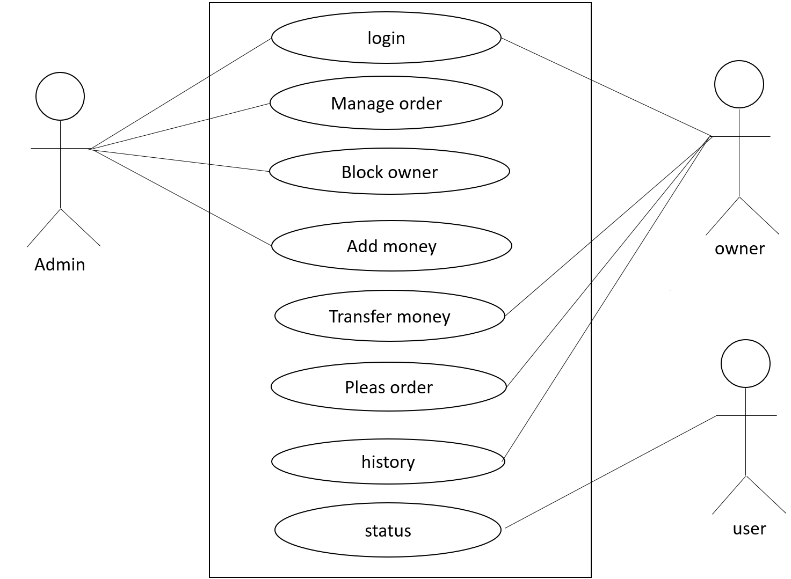
Use Case diagram

Slide 11
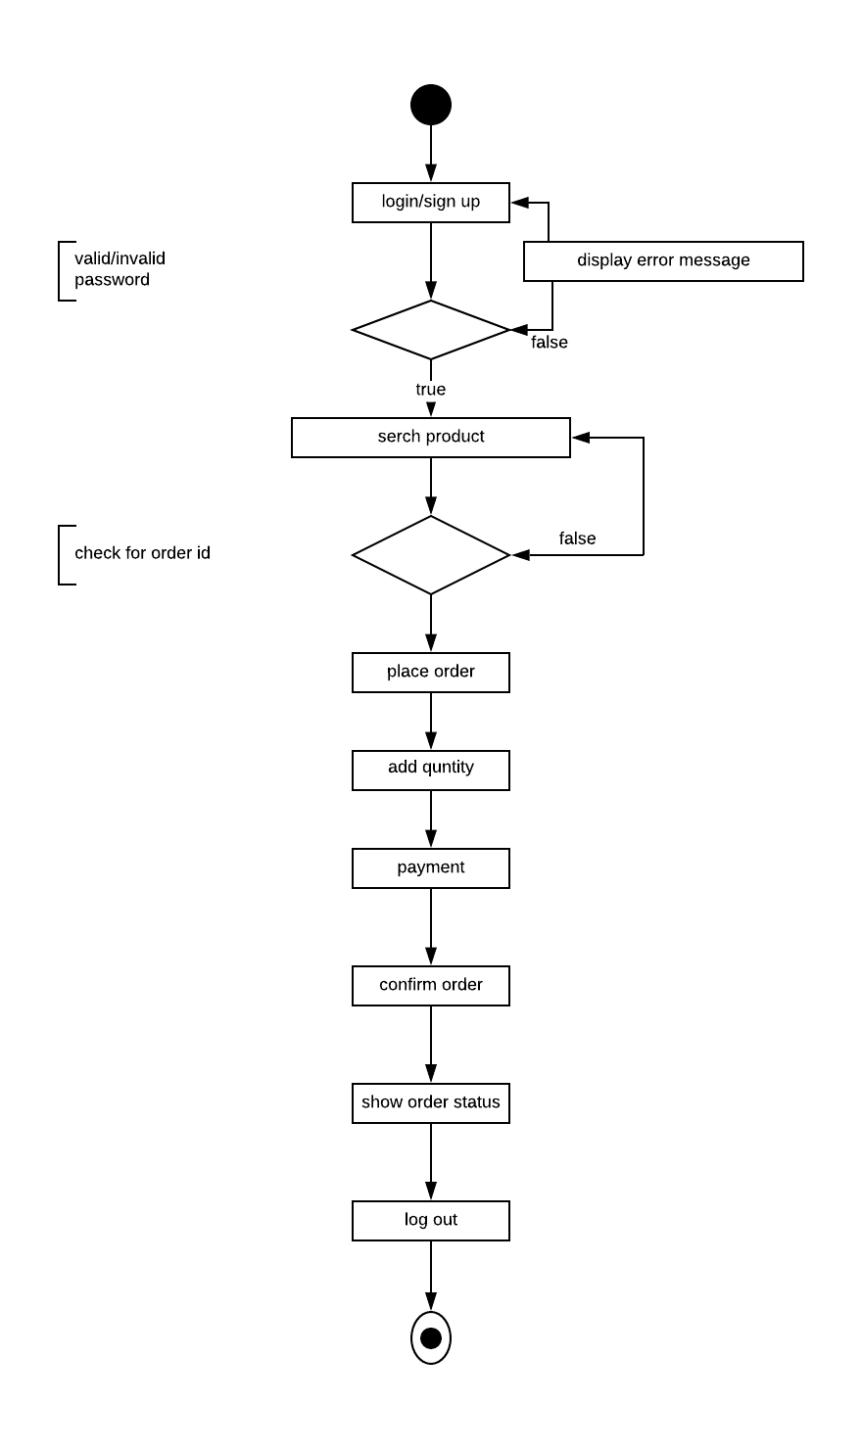
Activity diagram for place order

Slide 12
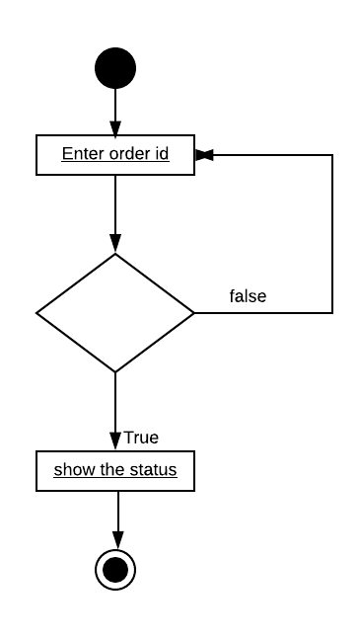
User : view status

Slide 13
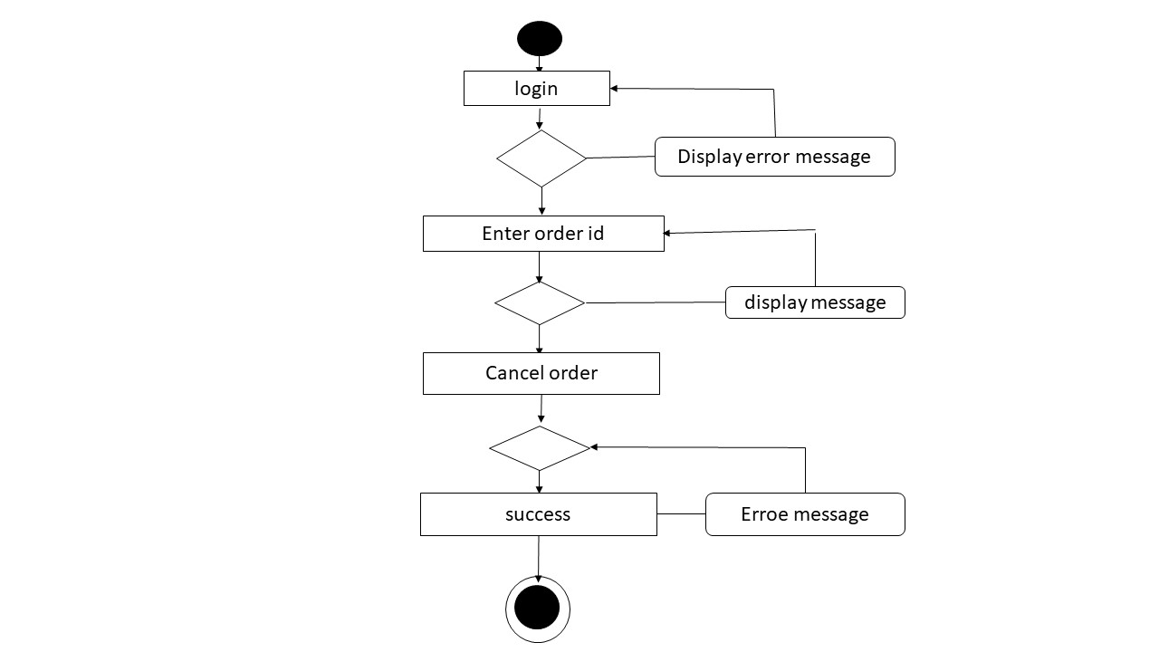
Activity Diagram Cancel Order

Slide 14
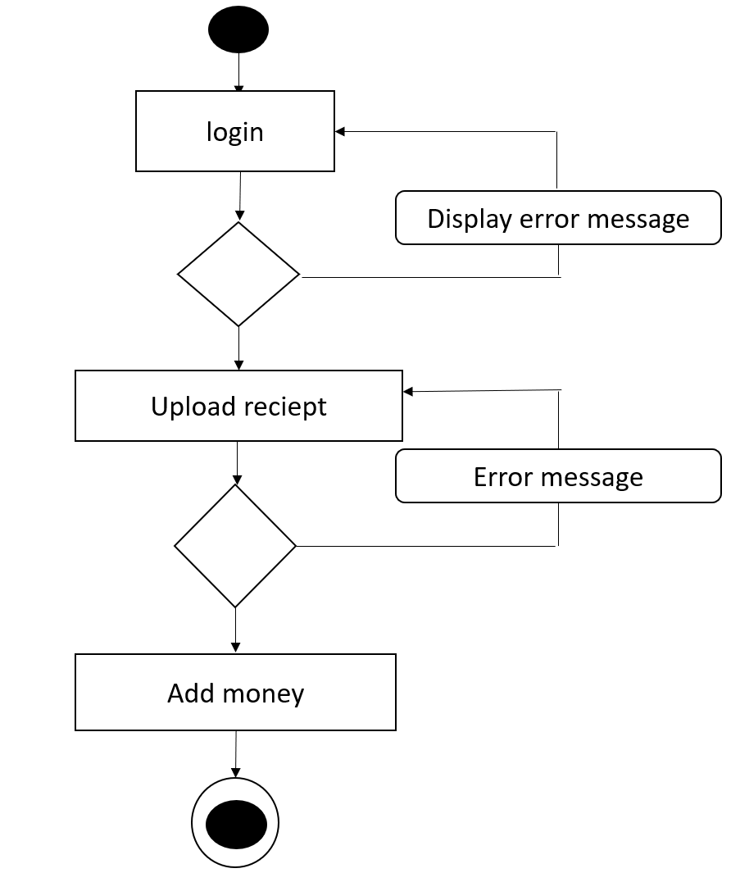
Activity diagram to Add money

Slide 15
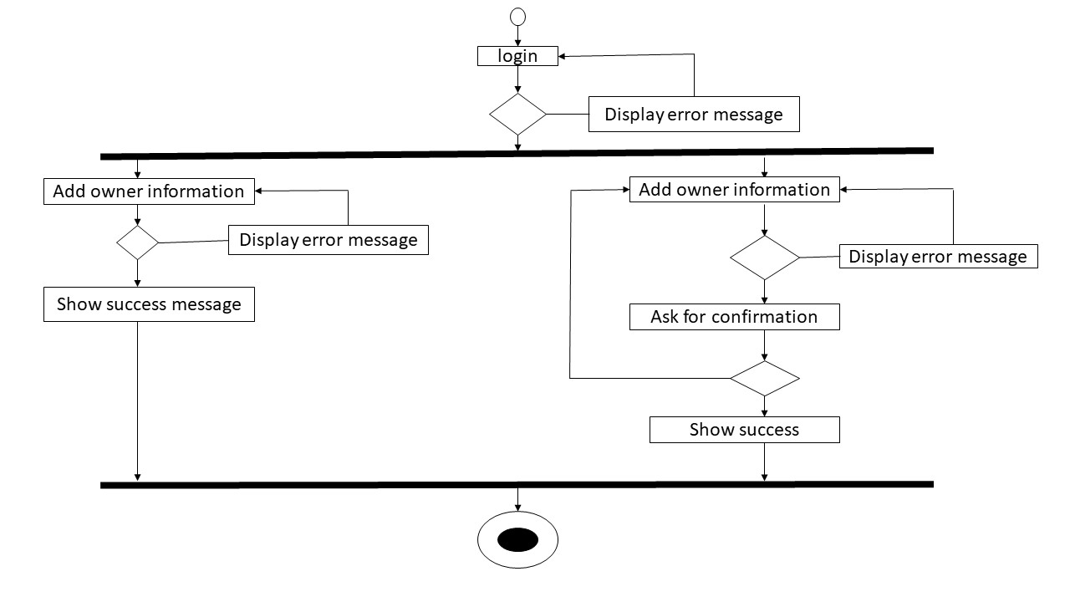
Activity Diagram Add/block owner

Slide 16
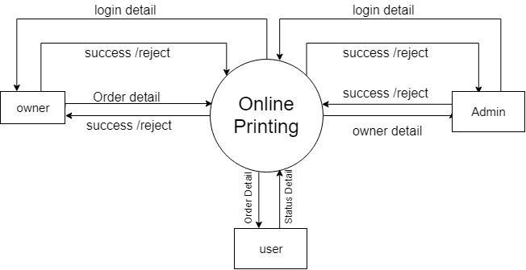
Level 0 DFD :-

Slide 17
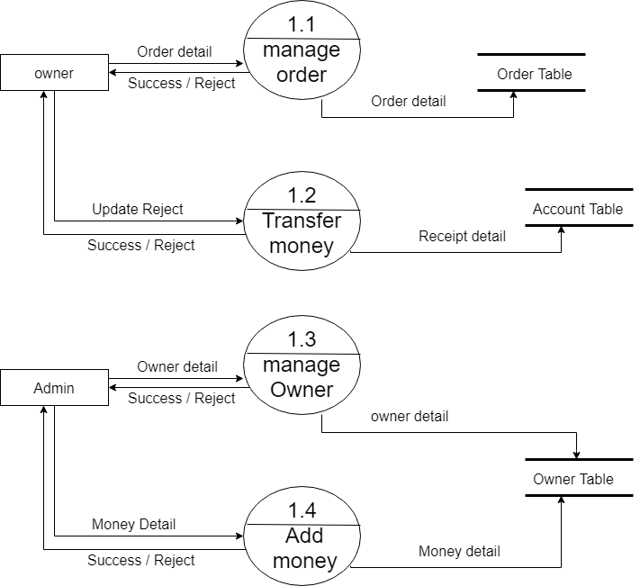
Level 1 DFD

Slide 18
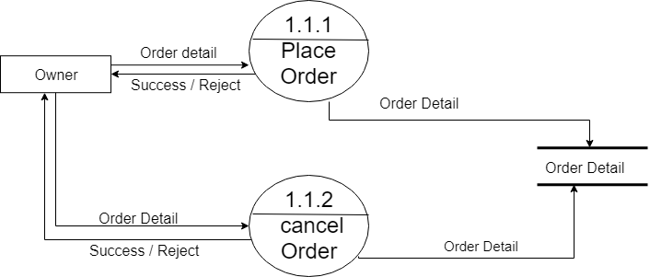
DFD level 2 Manage Order

Slide 19
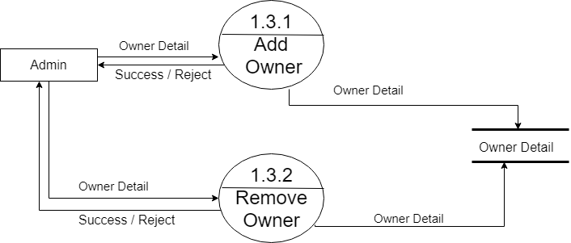
DFD level 2: add/remove owner

Slide 20
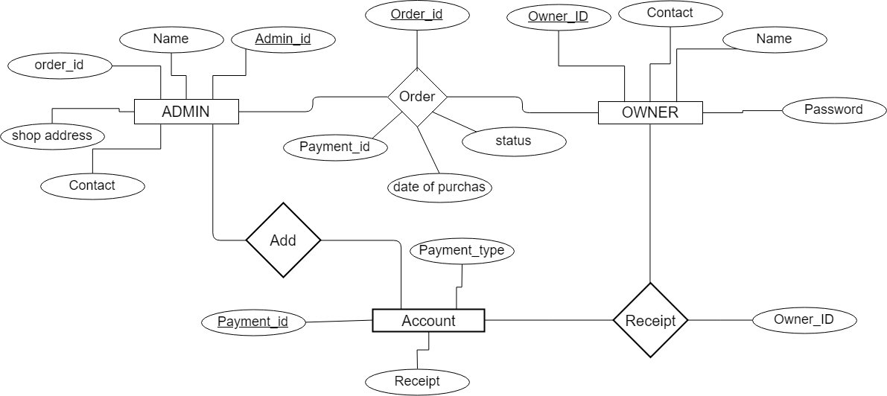
ER Diagram

Slide 21


